Slide 1
Problem of chapter 3

Slide 2
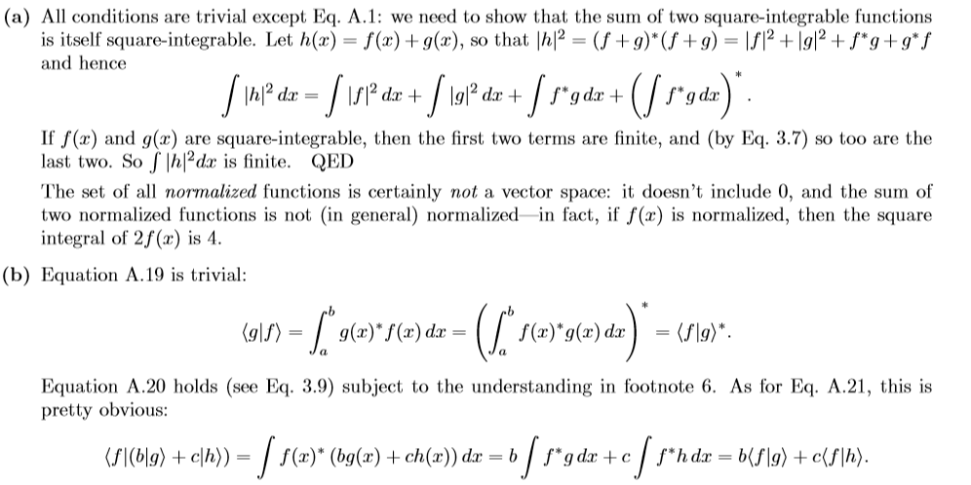
Problem 3.1(P96)

Slide 3
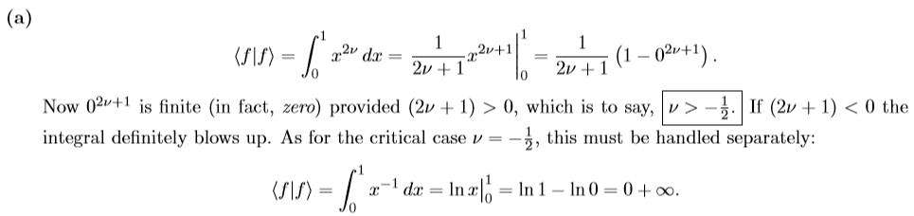
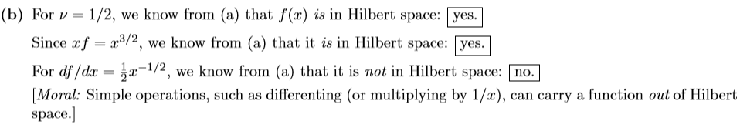
Problem 3.2(P96)

Slide 4







Problem 3.3(P98)

Slide 5
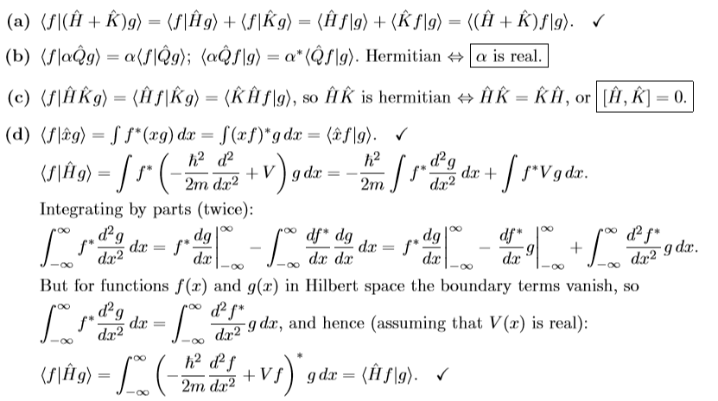
Problem 3.4(P98)

Slide 6
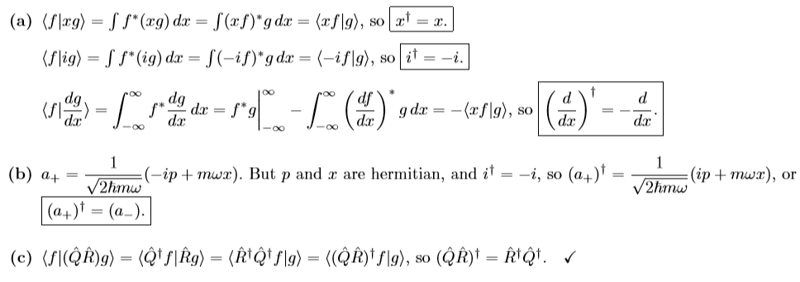
Problem 3.5(P98)

Slide 7
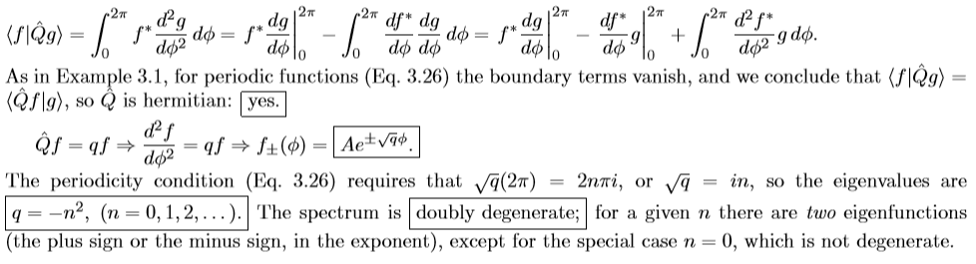
Problem 3.6(P100)

Slide 8
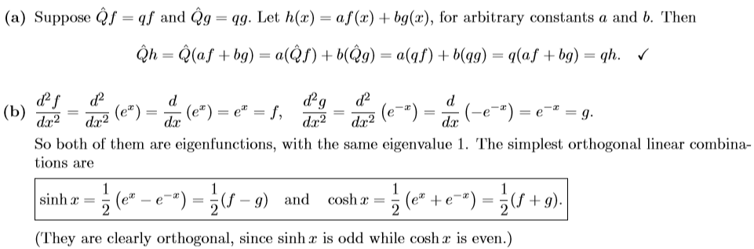
Problem 3.7(P102)

Slide 9
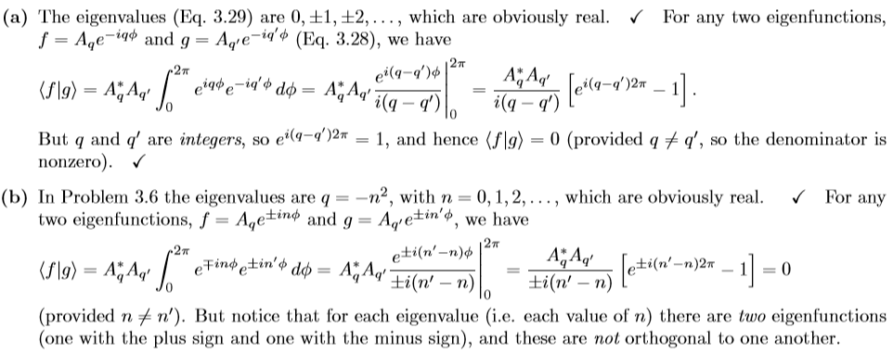
Problem 3.8(P103)

Slide 10
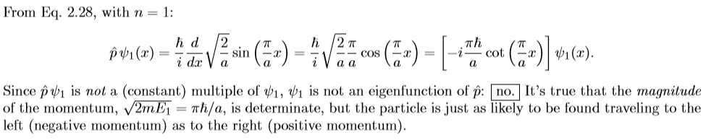
Problem 3.9(P105)
Problem 3.10(P106)

Slide 11
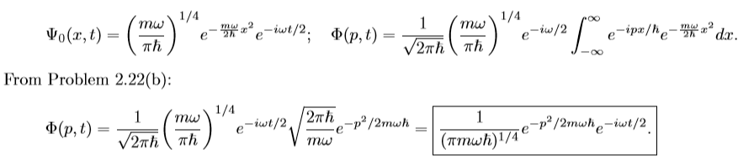
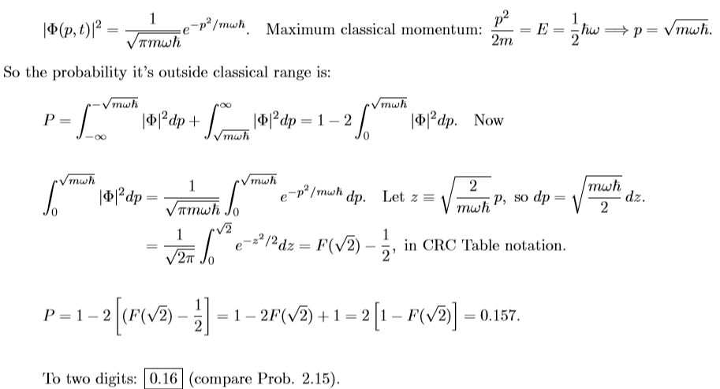
Problem 3.11(P109)

Slide 12
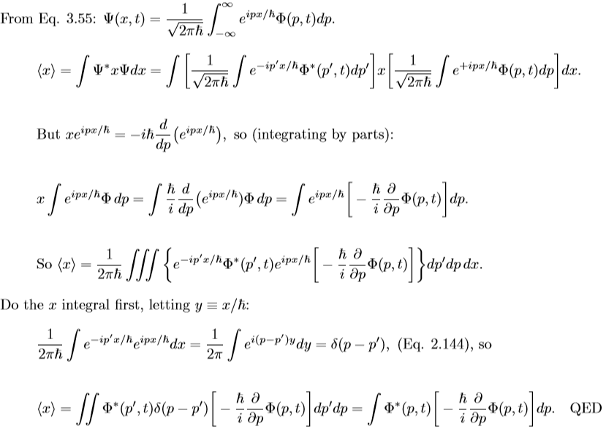
Problem 3.12(P109)

Slide 13





Problem 3.13(P112)

Slide 14
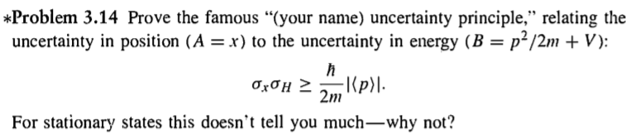


Problem 3.14(P113)

Slide 15

Problem 3.15(P113)

Slide 16
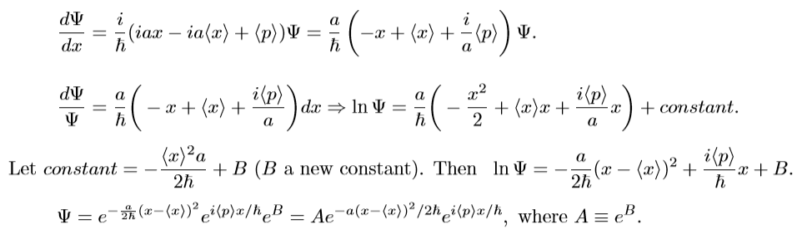
Problem 3.16(P114)

Slide 17
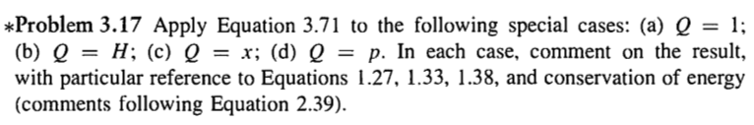







Problem 3.17(P118)

Slide 18
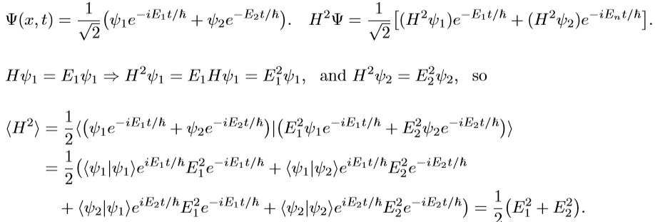


Problem 3.18(P118)

Slide 19







Slide 20



Problem 3.20(P118)
Problem 3.14

Slide 21



Problem 3.21(P123)
$${\hat{p}}^{2}\left|\left.β\right\rangle =\left|\left.α\right\rangle \left.\left\langle α\right.\right|\left.α\right\rangle \left.\left\langle α\right.\right|\right.\left.β\right\rangle =\left|\left.α\right\rangle \left.\left\langle α\right.\right|\right.\left.β\right\rangle =\hat{p}\left|\left.β\right\rangle \right.\right.$$
$$λ=0,1$$

Slide 22






Problem 3.28(P125)

Slide 23


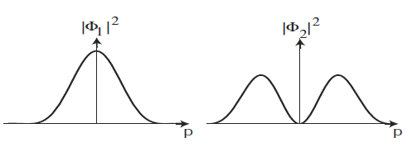

Slide 24






Problem 3.39(P129)

Slide 25







Slide 26








Problem 3.40(P130)

Slide 27







